Slide 1
Accounting Principles, 7th Edition
Weygandt • Kieso • Kimmel
Chapter 7
Accounting Information Systems
Prepared by Naomi Karolinski
Monroe Community College
and
Marianne Bradford
Bryant College
John Wiley & Sons, Inc. © 2005

Slide 2
CHAPTER 7 ACCOUNTING INFORMATION SYSTEMS
After studying this chapter, you should be able to:
1 Identify basic principles of accounting information systems.
2 Explain the major phases in the development of an accounting system.
3 Describe the nature and purpose of a subsidiary ledger.
4 Explain how special journals are used in journalizing.
5 Indicate how a multi-column journal is posted.

Slide 3
ACCOUNTING INFORMATION SYSTEMS
STUDY OBJECTIVE 1
Accounting information system (AIS)
Collects and processes data.
Disseminates financial information to interested parties.
Can either be manual or computerized.

Slide 4
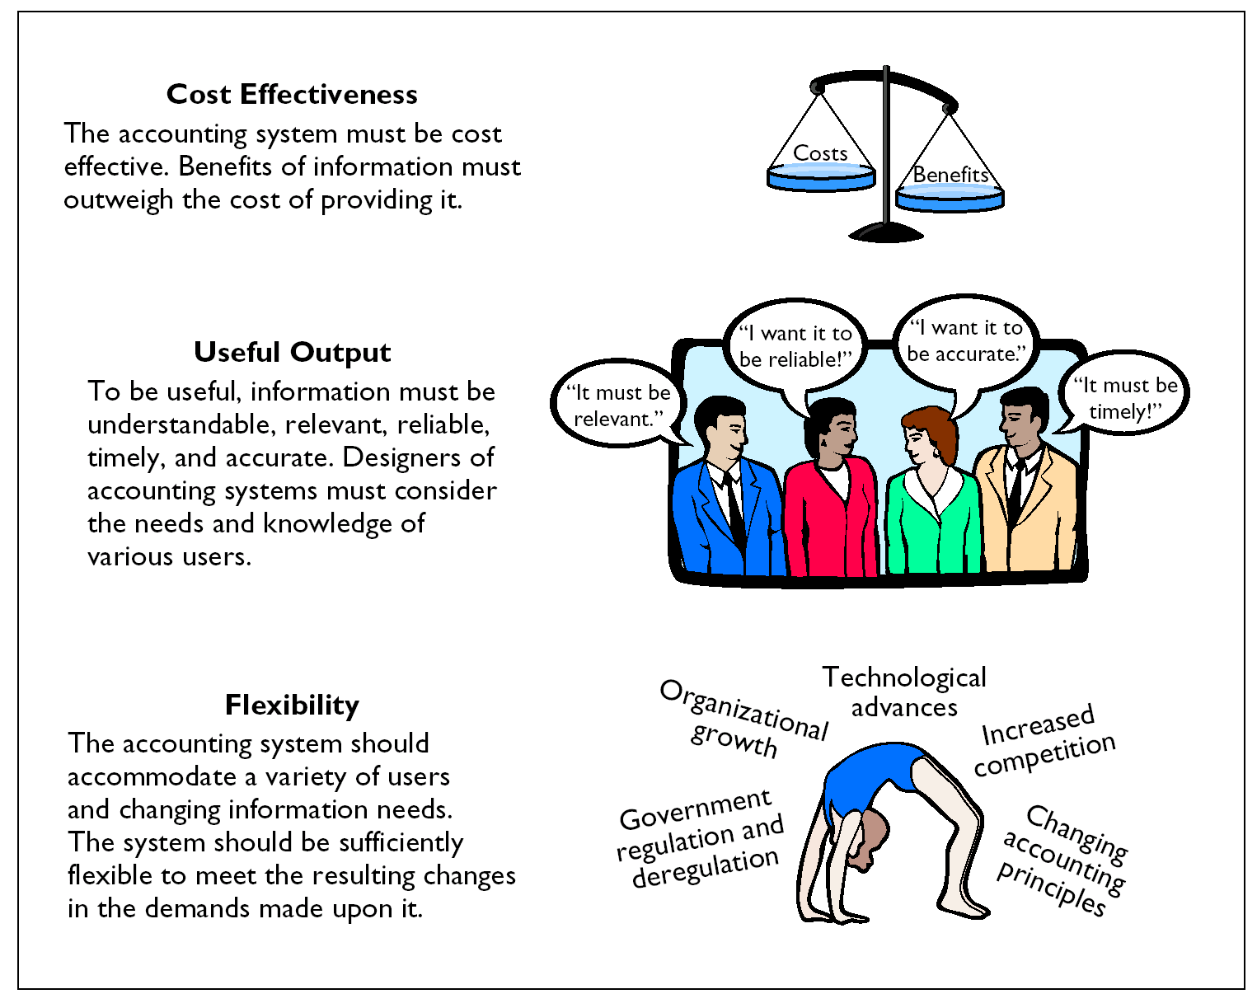
PRINCIPLES OF AN EFFICIENT AND EFFECTIVE ACCOUNTING INFORMATION SYSTEM

Slide 5
PHASES IN THE DEVELOPMENT OF AN ACCOUNTING SYSTEM
Study Objective 2
Analysis
Planning and identifying information needs and sources
Follow-up
Design
Monitoring and correcting any weaknesses
Creating forms, documents, procedures, job descriptions, and reports
Implementation
Installing the system, training personnel, and making the system wholly operational

Slide 6
MANUAL VS. COMPUTERIZED SYSTEMS
Small businesses-
  begin operations with manual accounting systems and convert to computerized systems as business grows
To understand computerized accounting systems-
  one must understand how manual accounting systems work

Slide 7
SUBSIDIARY LEDGERS
STUDY OBJECTIVE 3
A group of accounts
  With a common characteristic for example, all accounts receivable
  Facilitates the recording process freeing the general ledger from details concerning individual balances
Two common subsidiary ledgers
  Accounts Receivable Ledger
  Accounts Payable Ledger

Slide 8
CONTROL ACCOUNT
Control account
  General Ledger account which summarizes subsidiary ledger data
Subsidiary Ledger
  general ledger control account balance equals the composite balance of the individual accounts in the subsidiary ledger

Slide 9
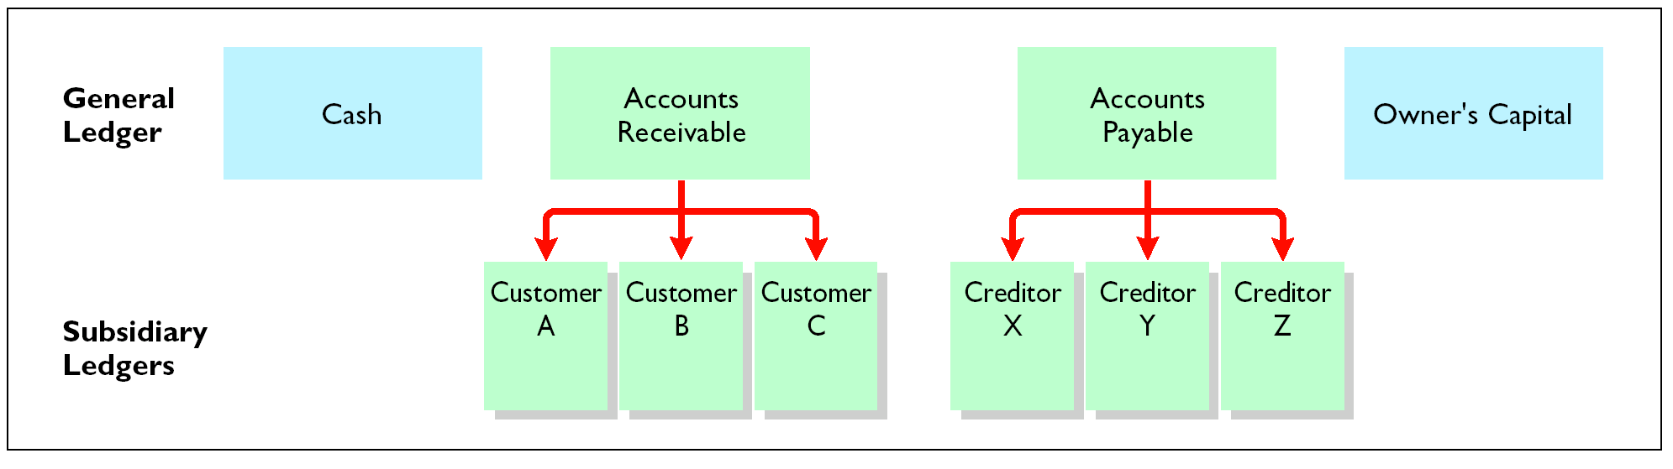
RELATIONSHIP OF GENERAL LEDGERS AND SUBSIDIARY ACCOUNTS

Slide 10
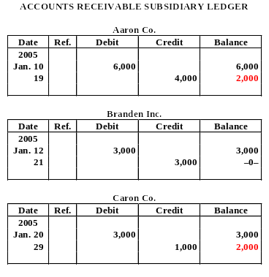
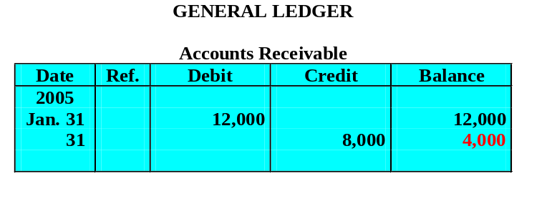
RELATIONSHIP BETWEEN LEDGERS
The subsidiary ledger is separate
from the general ledger.
Accounts Receivable is
a control account.

Slide 11
SUBSIDIARY LEDGERS
  Advantages
  1 Shows transactions affecting one customer or one creditor in a single account
  2 Frees the general ledger of excessive details
  3 Helps locate errors in individual accounts
  4 Reduces the number of accounts in one ledger and by using control accounts
  5 Division of labor in posting
  One employee posts to the general ledger
  Another employee posts to the subsidiary ledger

Slide 12
SPECIAL JOURNALS
STUDY OBJECTIVE 4
Special journals
  used to group similar types of transactions
  permits greater division of labor and reduces time needed to complete the posting process
If a transaction cannot be recorded in a special journal, it is recorded in the general journal.

Slide 13
USE OF SPECIAL JOURNALS AND THE GENERAL JOURNAL
Sales
Journal
Cash Receipts
Journal
Purchases Journal
Cash Payments
Journal
General
Journal
Used for:
All sales of
merchandise
on account
Used for:
All cash
received
(including
cash sales)
Used for:
All purchases
of merchandise
on account
Used for:
All cash paid
(including
cash
purchases)
Used for:
Transactions
that cannot
be entered
in a special
journal, including
correcting, adjusting, and closing entries
The types of special journals used depend largely on the types of transactions that occur frequently in a business enterprise.
Notes:
Can’t get yellow out behind CR journal

Slide 14
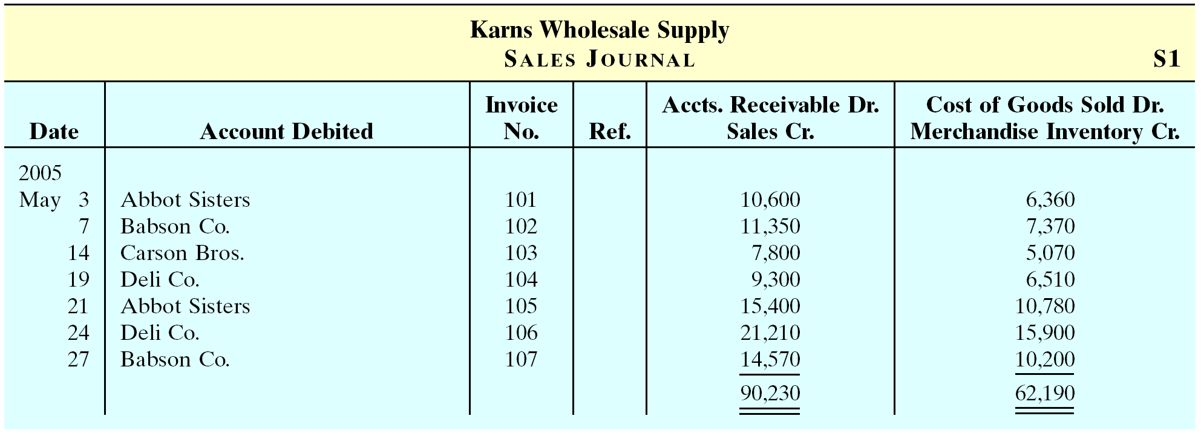
JOURNALIZING THE SALES JOURNAL PERPETUAL INVENTORY SYSTEM
Under a perpetual inventory system, one entry at selling price in the Sales Journal results in a debit to Accounts Receivable and a credit to Sales.
Another entry at cost results in a debit to Cost of Goods Sold and a credit to Merchandise Inventory.
Only one line is needed to record each transaction and all entries are made from sales invoices.

Slide 15
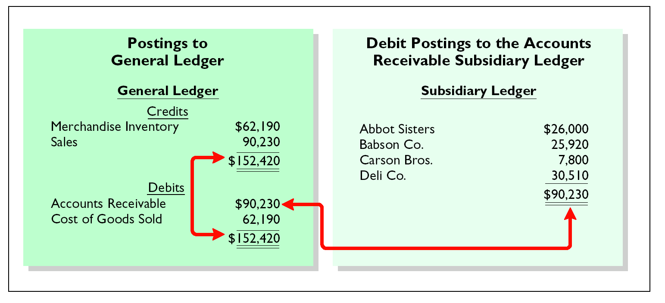
PROVING THE EQUALITY OF THE POSTINGS FROM THE SALES JOURNAL
To prove the ledgers it is necessary to determine that 1 the total of the general ledger debit balances must equal the total of the general ledger credit balances and 2 the sum of the subsidiary ledger balances must equal the balance in the control account.

Slide 16
ADVANTAGES OF A SALES JOURNAL
1 One-line entry
saves time
not necessary to write out four account titles for each transaction
2 Only totals are posted to the general ledger
saves posting time
reduces the possibilities of errors in posting
3 Division of labor
one individual may take responsibility for the sales journal

Slide 17
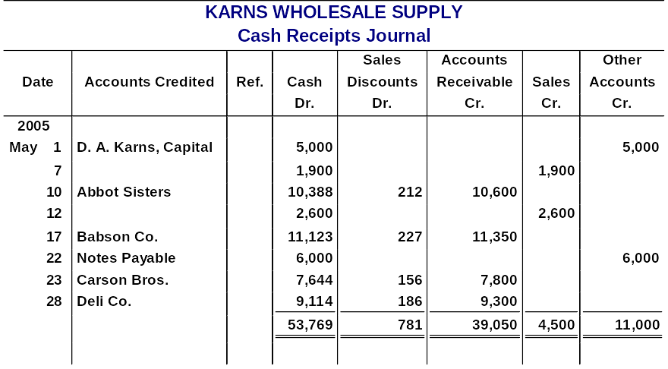
CASH RECEIPTS JOURNAL
Has debit columns for Cash, Sales Discounts, and Cost of Goods Sold, and credit columns for Accounts Receivable, Sales, Other Accounts, and Merchandise Inventory.
Involves posting all column totals once at the end of the month to the appropriate accounts.
Note: The journal above doesn’t show the Cost of Goods Sold Dr. and Merchandise Inventory Cr. column.

Slide 18
If a customer returns goods for credit, an entry is normally made in the:
Review
cash payments journal.
sales journal.
general journal.
cash receipts journal.

Slide 19
Review
If a customer returns goods for credit, an entry is normally made in the:
cash payments journal.
sales journal.
general journal.
cash receipts journal.

Slide 20
CASH RECEIPTS JOURNAL
  The total of the Other Accounts column is not posted. The individual amounts comprising the total are posted separately to the general ledger accounts specified in the Accounts Credited column.
  The individual amounts in a column are posted daily to the subsidiary ledger account specified in the Accounts Credited column.

Slide 21
PROVING THE EQUALITY OF THE CASH RECEIPTS JOURNAL
Debits
Credits
Cash
$53,769
Accounts Receivable
$ 39,050
Sales Discounts
781
Sales
4,500
Cost of goods sold
2,930
Other Accounts
11,000
$57,480
Merchandise Inventory
2,930
$ 57,480
When the journalizing of a multi-column journal has been completed, the amount columns are totaled (footing), and the totals are compared to prove the equality of the debits and credits (cross-footing).

Slide 22
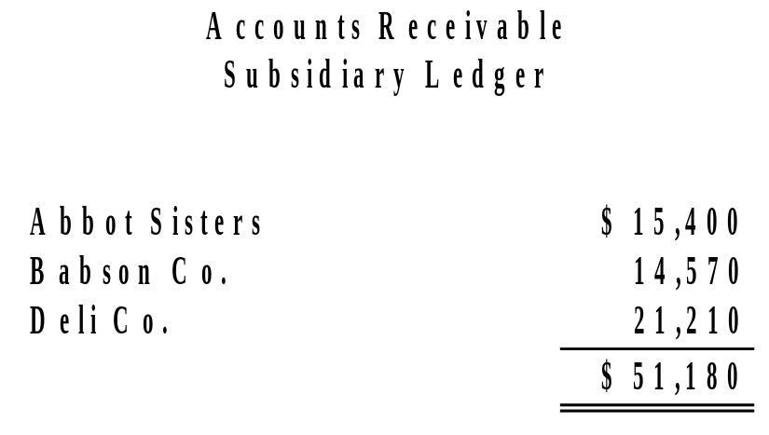
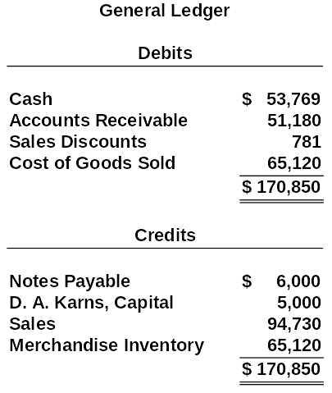
PROVING THE LEDGERS AFTER POSTING THE SALES AND THE CASH RECEIPTS JOURNALS
STUDY OBJECTIVE 5
After the posting of the cash receipts journal is completed, it is necessary to prove the ledgers. The general ledger totals are in agreement. Also, the sum of the subsidiary ledger balances equals the control account balance.

Slide 23
PURCHASES JOURNAL
KARNS WHOLESALE SUPPLY
Purchases Journal
Merchandise
Inventory Dr.
Date
Account Credited
Terms
Ref.
Accounts Payable Cr.
2005
May 6
Jasper Manufacturing Inc.
2/10, n/30
11,000
10
Eaton and
Howe Inc.
3/10, n/30
7,200
14
Fabor and Son
1/10, n/30
6,900
19
Jasper Manufacturing Inc.
2/10, n/30
17,500
26
Fabor and Son
1/10, n/30
8,700
29
Eaton and
Howe Inc.
3/10, n/30
12,600
63,900
Each entry results in a debit to Merchandise Inventory and a credit to Accounts Payable.
All entries are made from purchase invoices.
Postings are made daily to the accounts payable subsidiary journal and monthly to the general ledger.

Slide 24
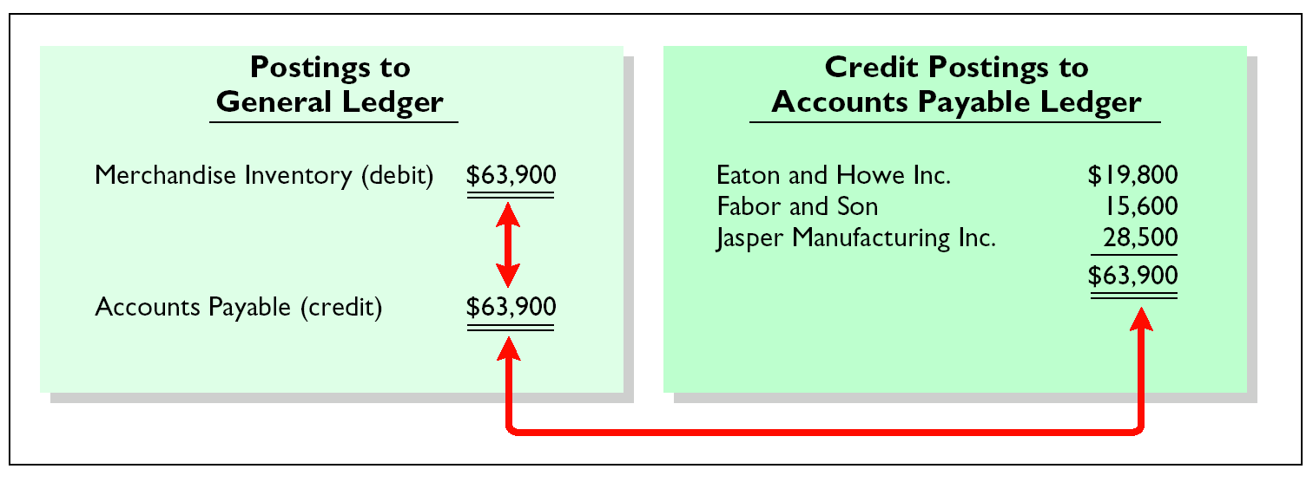
PROVING THE EQUALITY OF THE PURCHASES JOURNAL
To prove the ledgers it is necessary to determine that 1 the total of the general ledger debit balances equals the total of the general ledger credit balances and 2 the sum of the subsidiary ledger balances equals the balance in the control account.

Slide 25
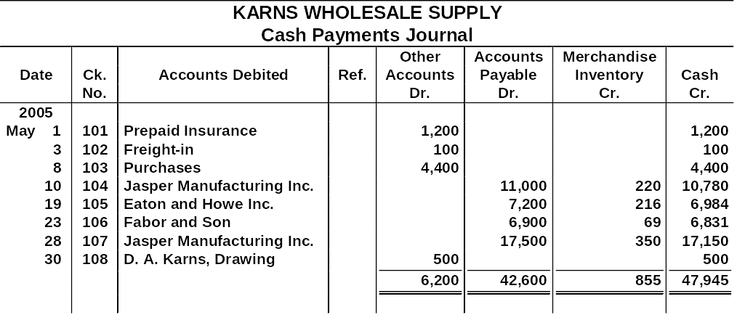
CASH PAYMENTS JOURNAL
Has multiple columns because of the multiple reasons that cash payments may be made.
Journalizing procedures are similar to cash receipts journal.
All entries are made from pre-numbered checks.
Posting procedures are also like the cash receipts journal.

Slide 26
EFFECTS ON GENERAL JOURNAL
Only transactions that cannot be entered in a special journal are recorded in the general journal.
When the entry involves both control and subsidiary accounts:
1 In journalizing, control and subsidiary accounts must be identified.
2 In posting there must be a dual posting (to the control account and subsidiary ledger).

Slide 27
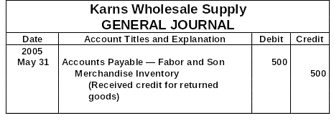
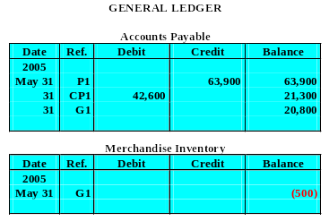
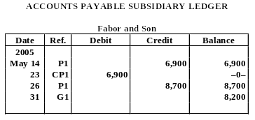
JOURNALIZING AND POSTING THE GENERAL JOURNAL
500
500
500

Slide 28

COPYRIGHT
Copyright © 2005 John Wiley & Sons, Inc. All rights reserved. Reproduction or translation of this work beyond that permitted in Section 117 of the 1976 United States Copyright Act without the express written consent of the copyright owner is unlawful. Request for further information should be addressed to the Permissions Department, John Wiley & Sons, Inc. The purchaser may make back-up copies for his/her own use only and not for distribution or resale. The Publisher assumes no responsibility for errors, omissions, or damages, caused by the use of these programs or from the use of the information contained herein.

Slide 29
Postings from the purchases journal to the subsidiary ledger are generally made:
Review
yearly.
monthly.
weekly.
daily.

Slide 30
Review
Postings from the purchases journal to the subsidiary ledger are generally made:
yearly.
monthly.
weekly.
daily.

